Slide 1
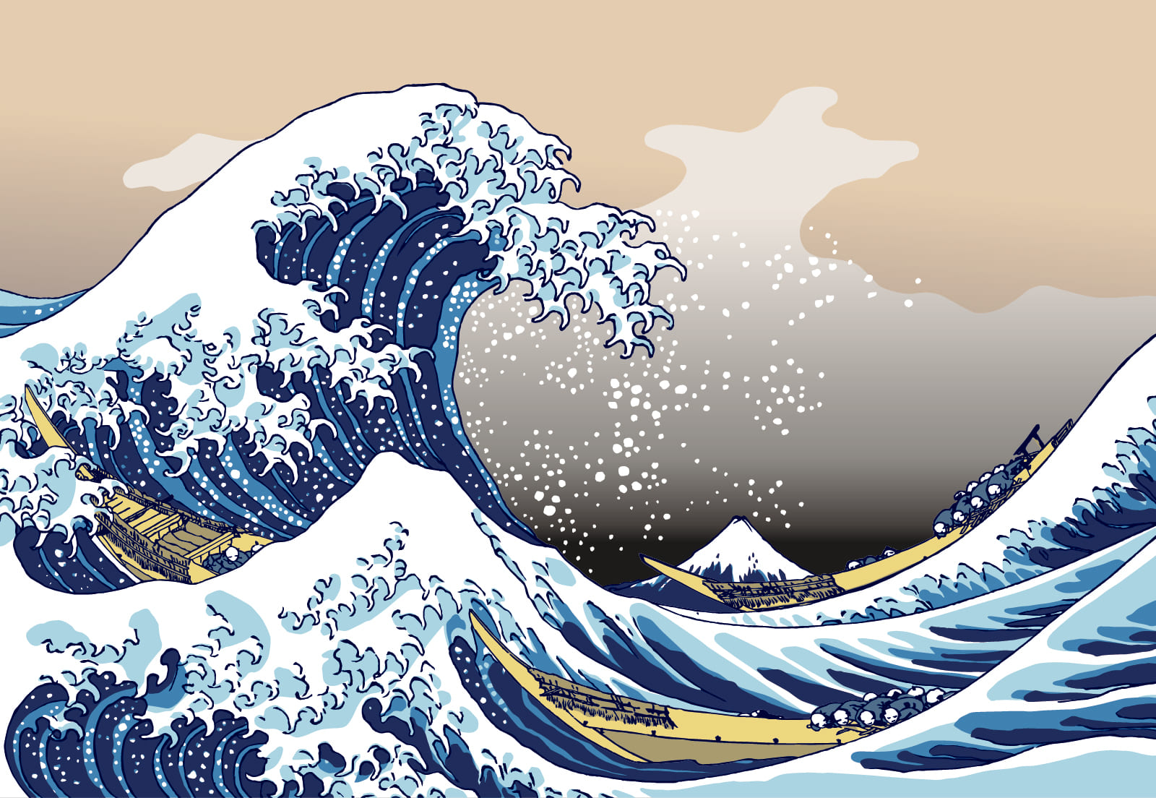
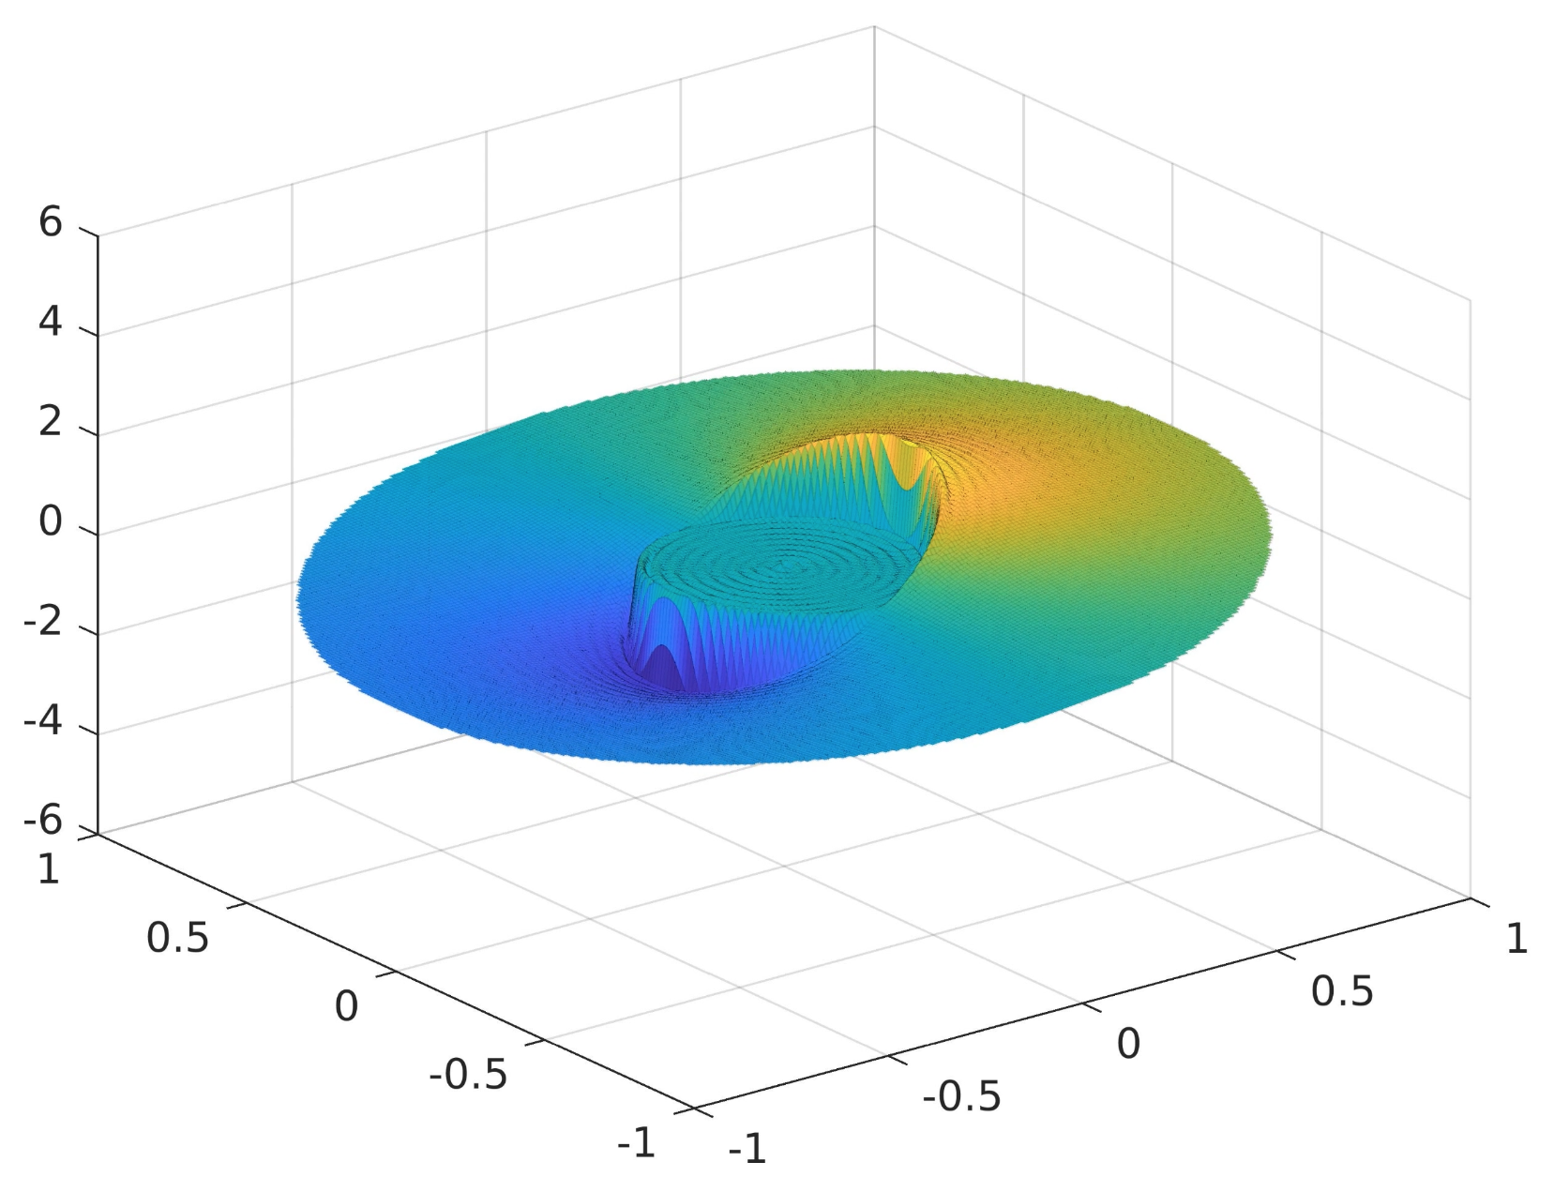

WAVE: Comparing Numerical Methods on Cylindrical Wave Equation Solver Performance
APC523 Final Project
Michael D. Walker (mw6136)
Philip Satterthwaite (ps1639)
Michael Schroeder (ms2774)
PhD Candidates
Mech. & Aero. Engineering
Kanagawa-oki Nami Ura. The Great Wave off Kanagawa.

Slide 2
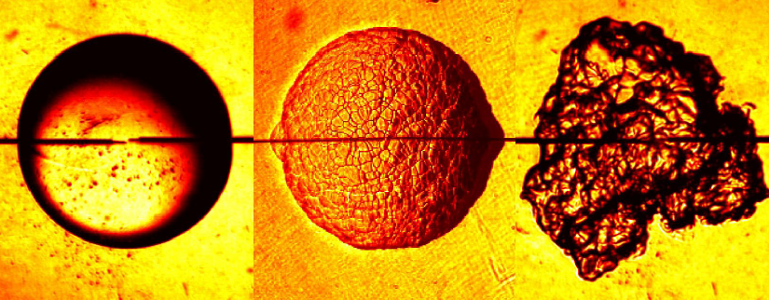
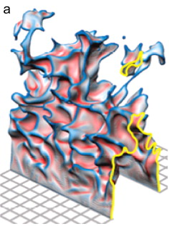
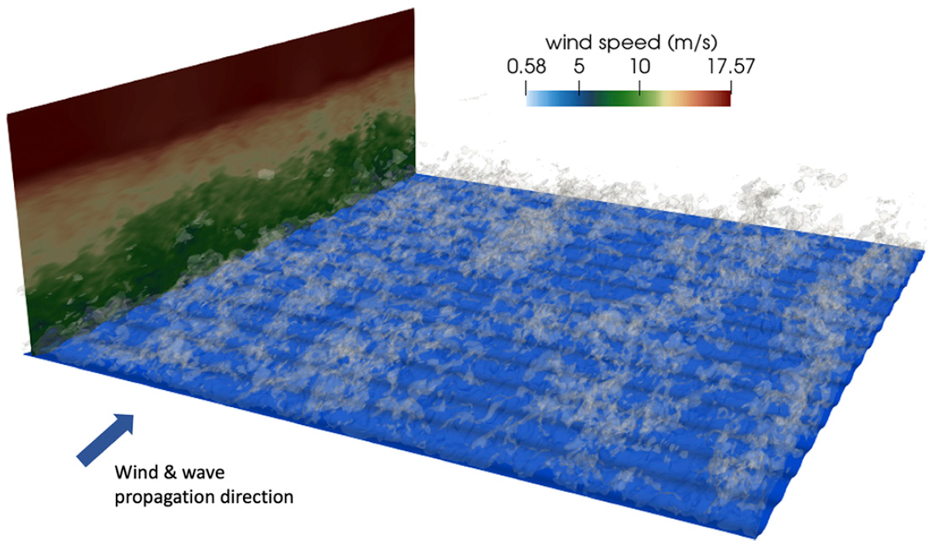
Motivation
The ability to understand and predict surface deformation is of great importance to a broad range of applications in fluid dynamics. Particular to our research (lab: CTRFL) are the ocean surface perturbed by wind, and combustion processes (modeled as an iso-surface of fast-reacting chemistry) perturbed by turbulence. Understanding these deformations requires solving high-order partial differential equations, a task that is often impossible to do mathematically and must be done numerically.
We seek to build a model of surface deformation by solving the scalar wave equation in cylindrical coordinates. Thereby resolving waves on the surface of a fluid generated by the motion of the walls. Further, we will investigate the trade-offs between speed, cost, accuracy, and stability of various numerical methods.
Law et al. Three faces of a flame.
Driscoll, J. F. Progr. Energy Combust. Sci., 2008.
Deskos et al. J. Atmos. Sci., 2021.

Slide 3
Contributions
Michael Walker (mw6136):
.
Philip Satterthwaite (ps1639):
.
Michael Schroeder (ms2774):
Coded analytical solution
Created plots and exported data
Implemented, helped derive, and analyzed finite difference discretization method
Analyzed applicability of iterative methods to this problem

Slide 4
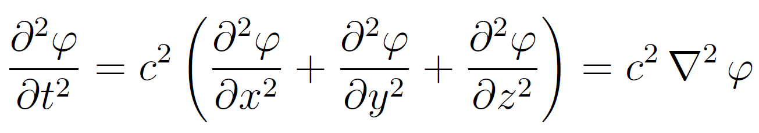
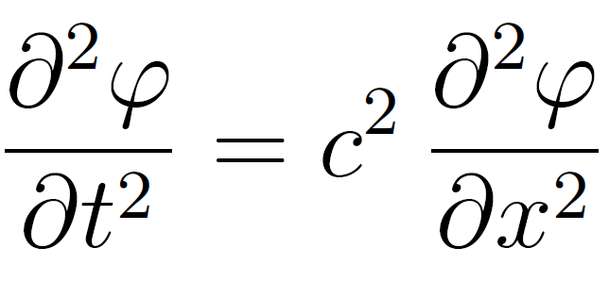
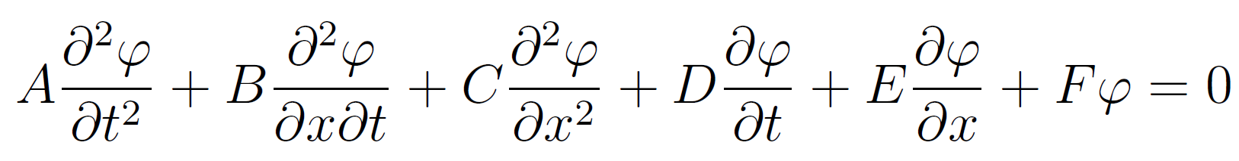
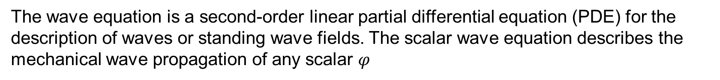
Wave Equation Classification
The wave equation is a second-order linear partial differential equation (PDE) for the description of waves or standing wave fields. The scalar wave equation describes the mechanical wave propagation of any scalar $φ$
1-D:
Projected in the 2nd order PDE general form gives $A = 1$, $B = 0$, and $C = −c^{2}$, and thus the discriminant $B^{2} − 4AC > 0$defines a hyperbolic PDE with a well-posed initial value problem.

Slide 5
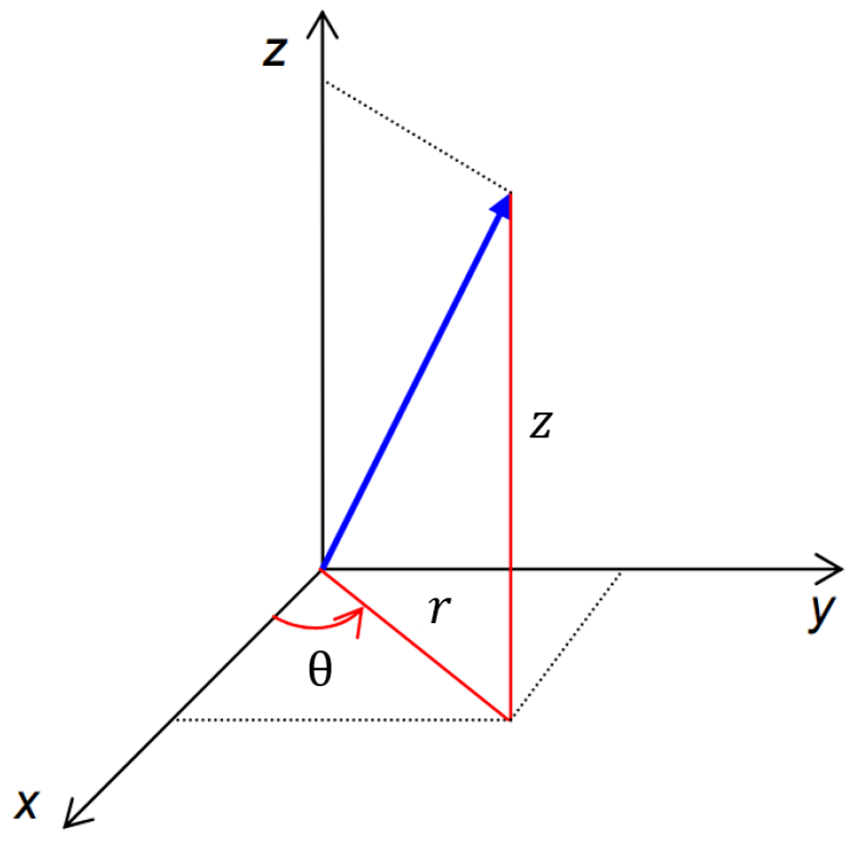
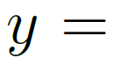
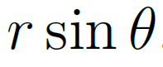
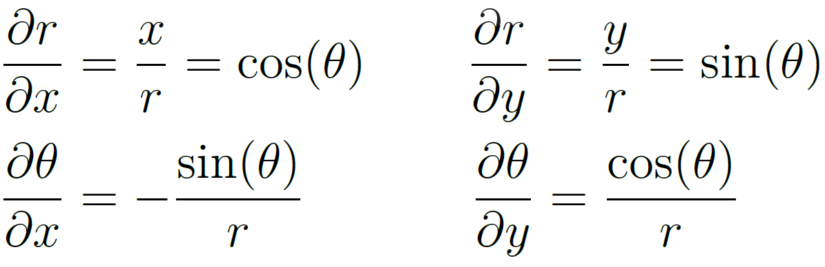
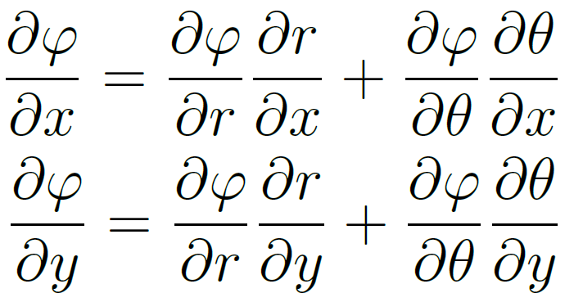
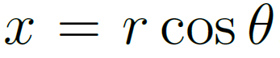
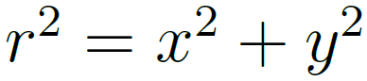
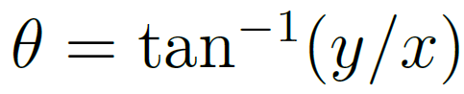
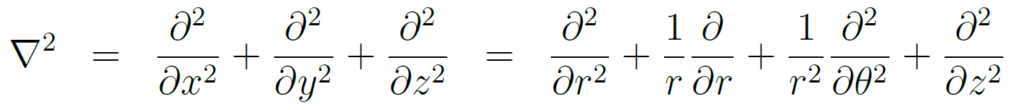
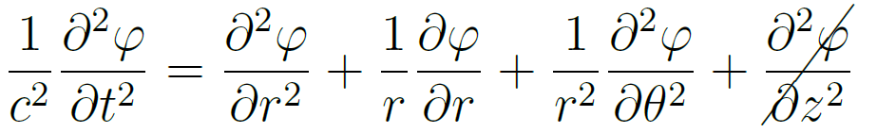
Cylindrical Wave Equation
For circularly propagating waves, it is useful to project the wave equation in cylindrical coordinates.
This remains a hyperbolic PDE, but with a singular point at the origin $r = 0$. The study of surface deformation requires only plane-polar coordinates, so the $∂^{2}φ/∂z^{2}$term may be neglected. We now seek an analytical solution to the 2-D equation, given well-posed boundary and initial conditions.

Slide 6
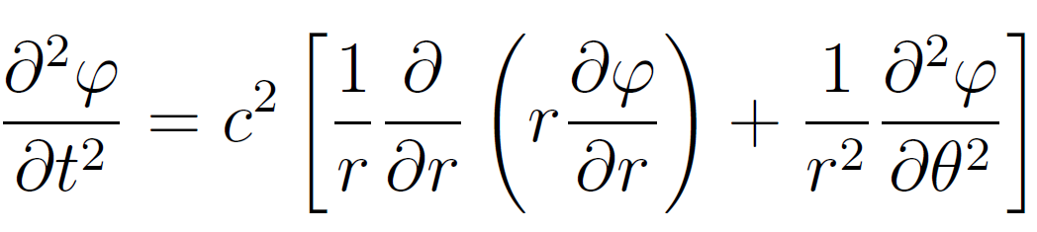
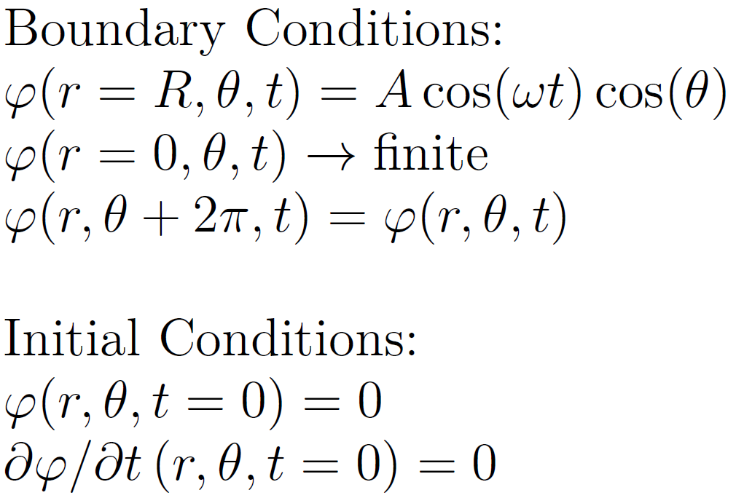
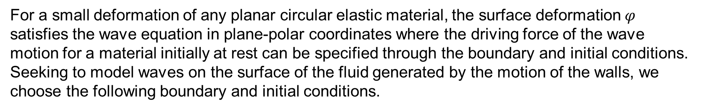
Problem Statement
For a small deformation of any planar circular elastic material, the surface deformation $φ$ satisfies the wave equation in plane-polar coordinates where the driving force of the wave motion for a material initially at rest can be specified through the boundary and initial conditions. Seeking to model waves on the surface of the fluid generated by the motion of the walls, we choose the following boundary and initial conditions.
Boundary Conditions:
Initial Conditions:
We will solve for $φ$ for all $t$, $θ$, and $r$ using the method of separation of variables and eigenfunction expansions, then use properties of orthogonality to solve for coefficients.
Problem Set 9, Exercise 3. MAE501: Mathematical Methods of Engineering Analysis I, Fall 2023.

Slide 7
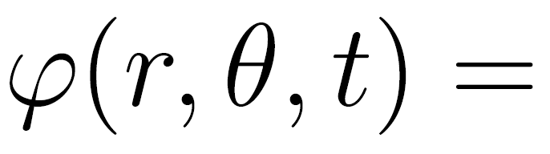
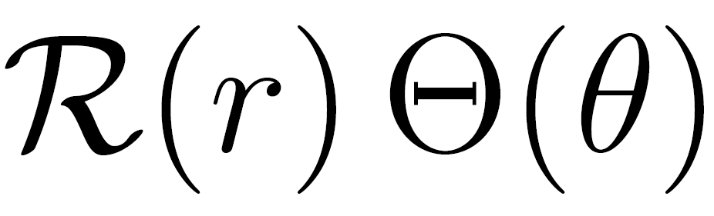
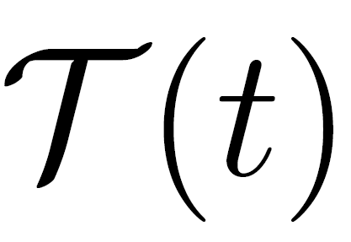
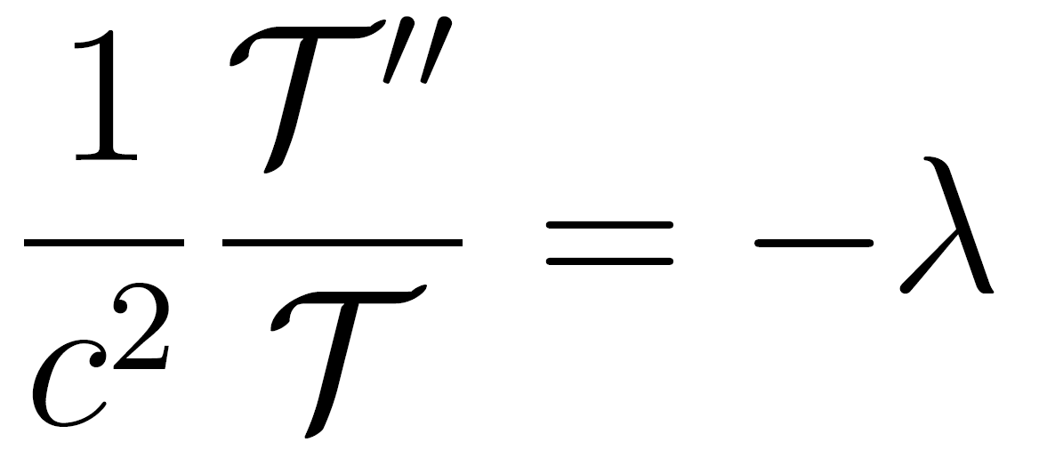
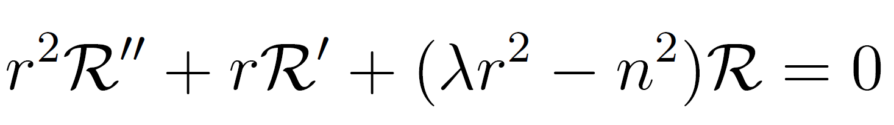
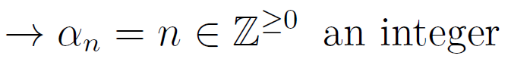
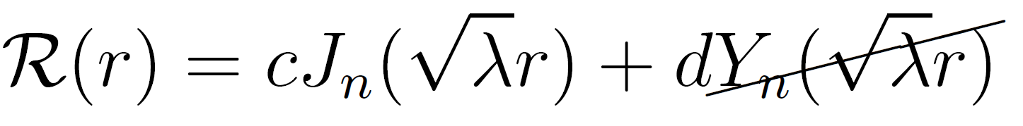
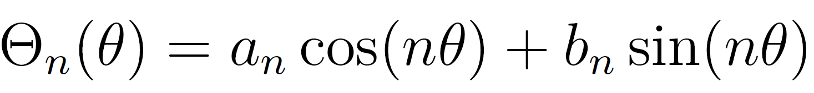
Analytical Solution
Separation of variables:
The Bessel Equation:
whose solution is the Bessel function:
See Appendix of project report for full derivation.

Slide 8
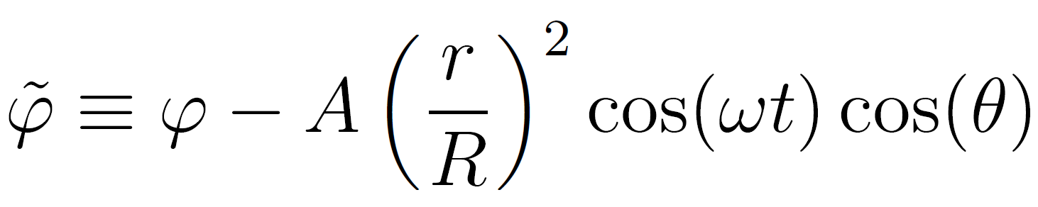
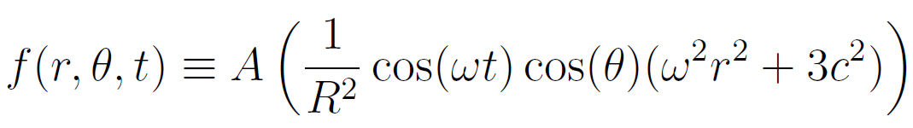
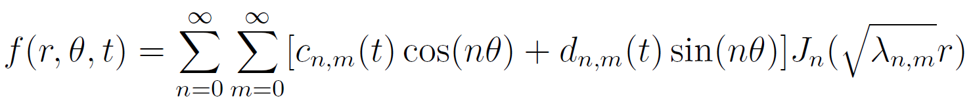
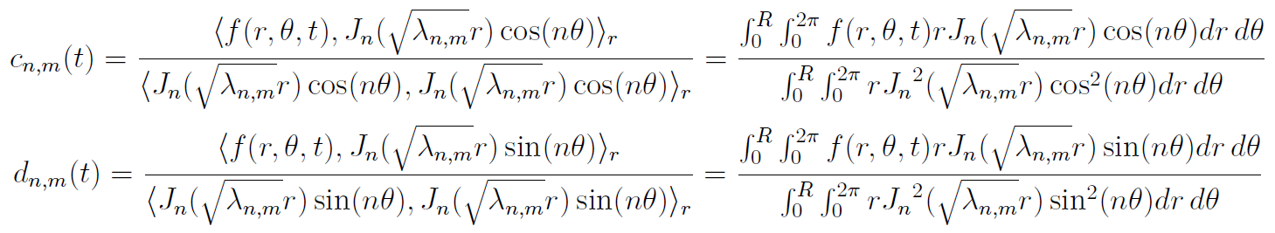
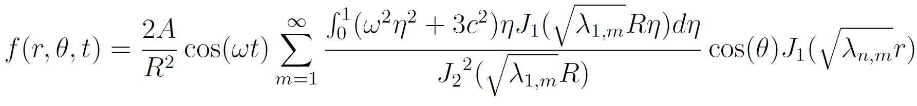
Analytical Solution (cont.)
Rescaling to achieve homogeneous boundary conditions:
Stationary Problem:
Eigenvalue expansion:
Solving for coefficients with orthogonality (inner product):
See Appendix of project report for full derivation.

Slide 9
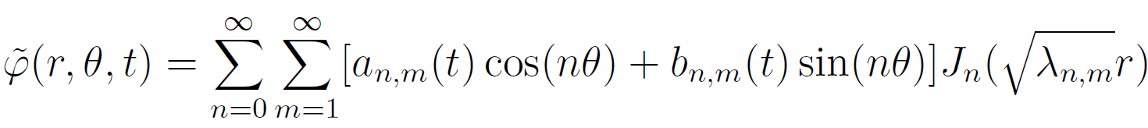
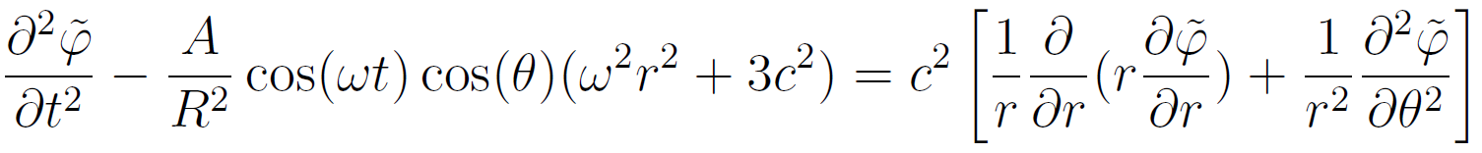
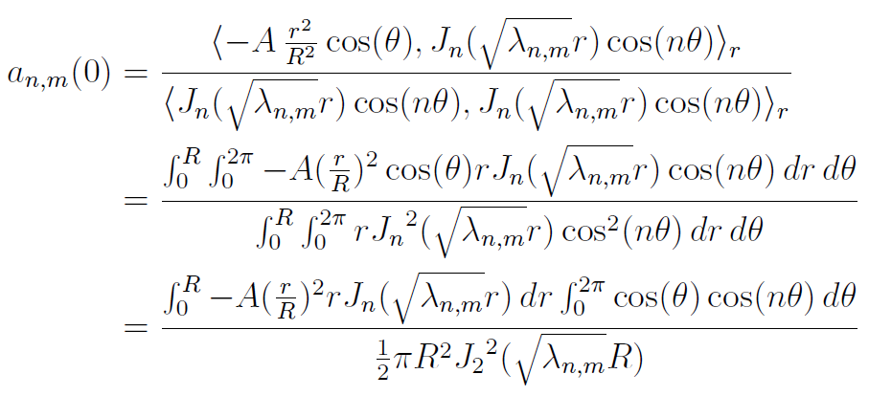
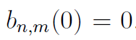

Analytical Solution (cont.)
Expanding $\tilde{φ}$:
Solving for coefficients with orthogonality (inner product) and initial conditions:
See Appendix of project report for full derivation.

Slide 10
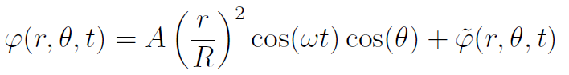
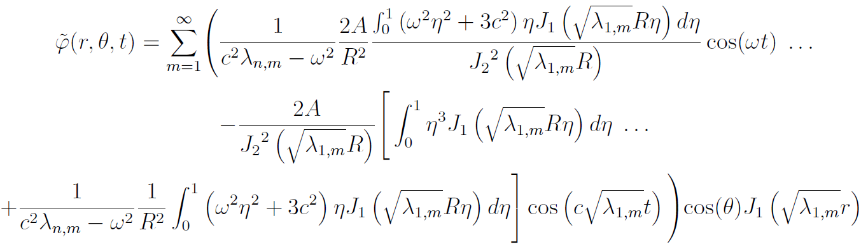
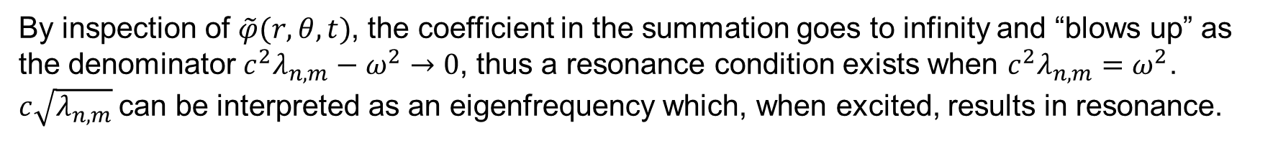
Analytical Solution (cont.)
Thus the final solution:
By inspection of $\tilde{φ}(r, θ, t)$, the coefficient in the summation goes to infinity and “blows up” as the denominator $c^{2}λ_{n,m}−ω^{2}→0$, thus a resonance condition exists when $c^{2}λ_{n,m}=ω^{2}$. $c\sqrt{λ_{n,m}}$can be interpreted as an eigenfrequency which, when excited, results in resonance.
See Appendix of project report for full derivation.

Slide 11
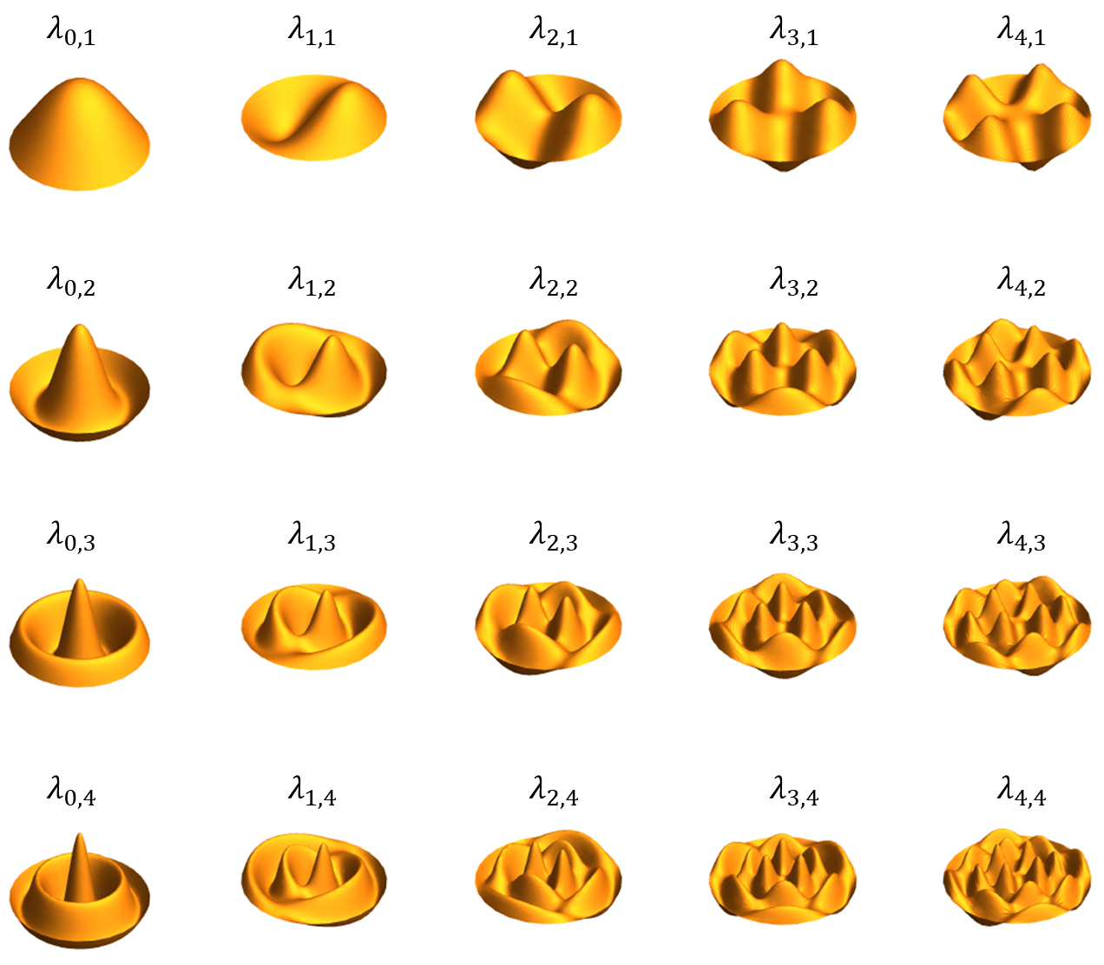
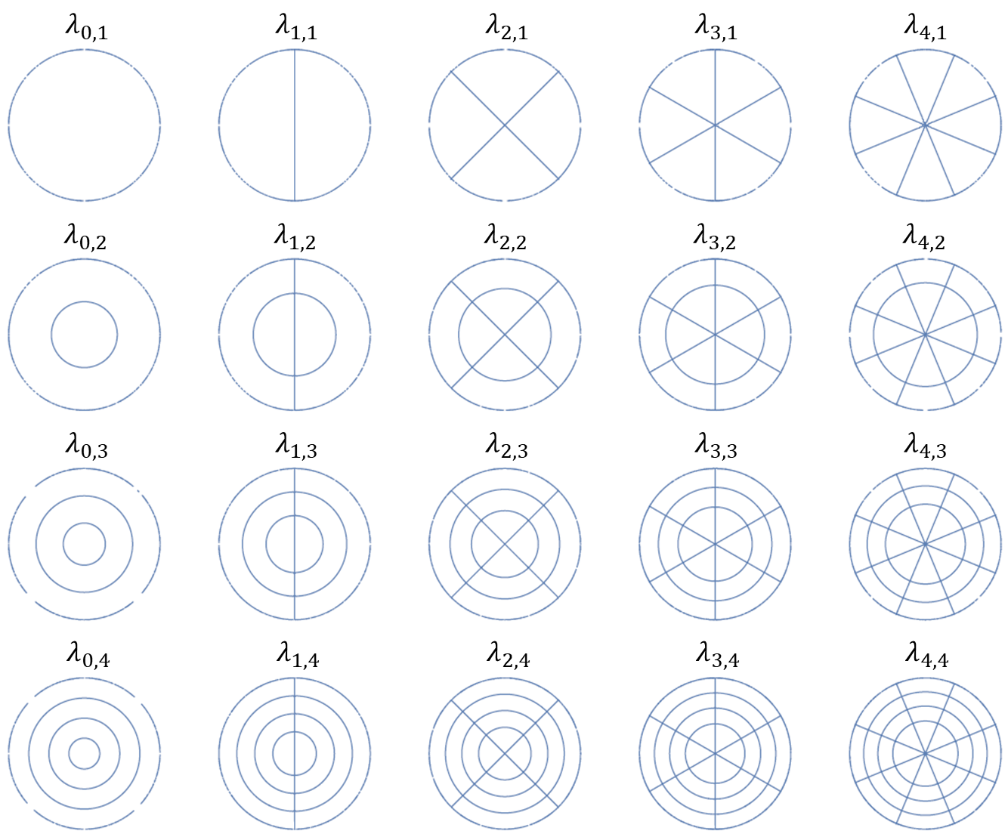
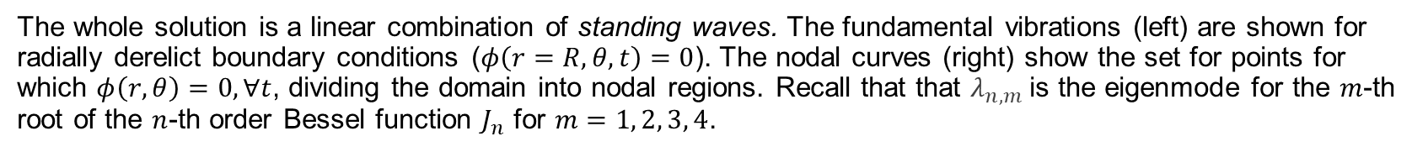
Fundamental Nodes
The whole solution is a linear combination of standing waves. The fundamental vibrations (left) are shown for radially derelict boundary conditions ($φ\left(r=R, θ, t\right)=0$). The nodal curves (right) show the set for points for which $φ\left(r, θ\right)=0, ∀t$, dividing the domain into nodal regions. Recall that that $λ_{n,m}$is the eigenmode for the $m$-th root of the $n$-th order Bessel function $J_{n}$ for $m=1, 2, 3, 4$.
Lecture Notes, Math 483/683: Partial Differential Equations. Spring 2023, NDSU.

Slide 12
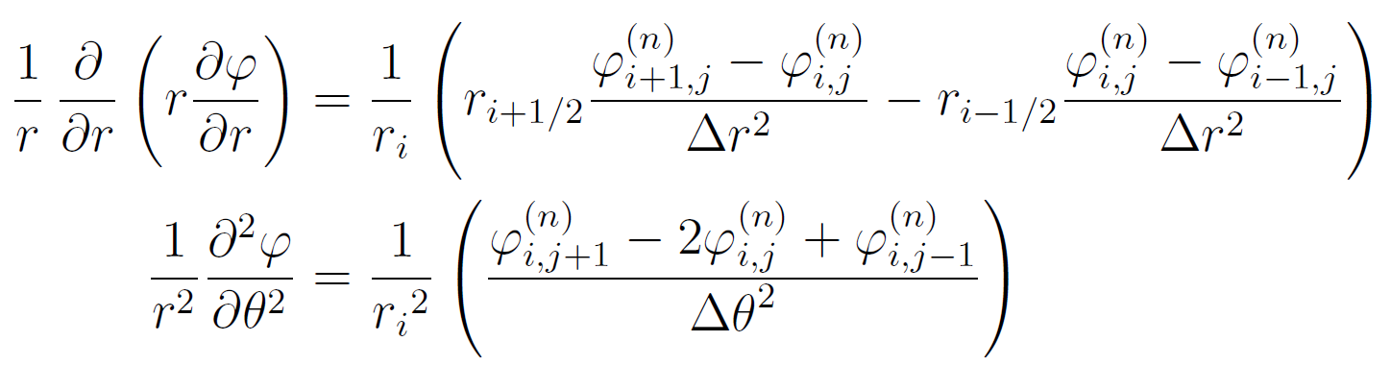
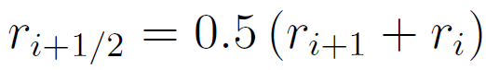
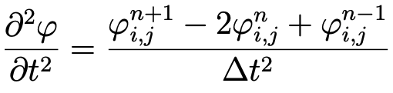
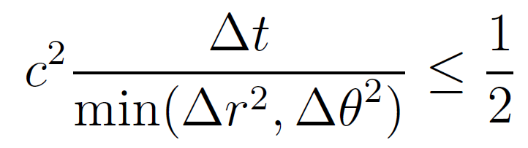
Discretization and Finite Difference
Define:
Using forward difference (explicit method) in $r$ and central differences in $θ$ and $t$
where
CFL condition:
E. F. Toro. Riemann Solvers and Numerical Methods for Fluid Dynamics, (2009).

Slide 13
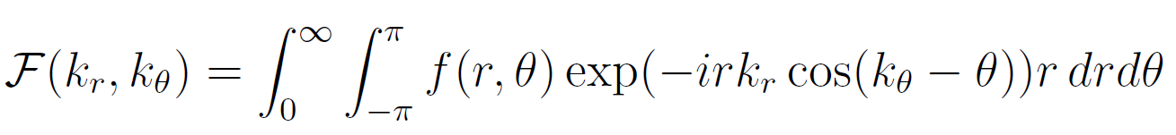




Fourier Spectral Methods
2-D Fourier Transform in polar coordinates and its inverse:
The Laplacian Fourier pair in polar coordinates:
Transform the scalar wave equation ($ℱ\left(φ\right)=\hat{φ}$) to obtain the Helmholtz equation with a time-forcing term:
1-D Helmholtz equation is a strict eigenvalue problem,
where the eigenvalue $k$ is the wavenumber
N. Baddour. Two-Dimensional Fourier Transforms in Polar Coordinates, (2011).

Slide 14



Fourier Spectral Methods (cont.)
Evolve the equation in time by choosing a simple Forward Euler iterative scheme:
The solution is obtained by then computing the inverse transform ($ℱ^{−1}(\hat{φ})=φ$). The discrete Fast Fourier Transform (FFT) is computed using the SciPy package (fft, ifft, fftfreq) in Python.
B. Costa. “Spectral Methods for Partial Differential Equations” CUBO, (2004).

Slide 15
Finite Difference (cont.)
Using backward difference (explicit method) in $r$ and central differences in $θ$ and $t$
Using the Crank-Nicolson scheme
To summarize, usually the Crank-Nicolson scheme is the most accurate scheme for small time steps. For larger time steps, the implicit scheme works better since it is less computationally demanding. The explicit scheme is the least accurate and can be unstable, but is also the easiest to implement and the least numerically intensive.

Slide 16
Numerical Scheme
Discretization/CFL condition
https://physics.stackexchange.com/questions/112900/discretizing-the-wave-equation-in-polar-coordinates
Explicit/Implicit Methods
https://hplgit.github.io/num-methods-for-PDEs/doc/pub/wave/html/._wave002.html
https://www.sciencedirect.com/science/article/pii/0096300384900067
https://www.math.arizona.edu/~leonk/papers/polarFD7.pdf
https://hplgit.github.io/num-methods-for-PDEs/doc/pub/wave/pdf/wave-4print-A4-2up.pdf
https://vfast.org/journals/index.php/VTM/article/download/1151/1036/3249
https://www.ndsu.edu/pubweb/~novozhil/Teaching/483%20Data/24.pdf
Benchmark: PDE2D or Matlab
https://pdetwod.wixsite.com/pde2d-1/copy-of-home
E. F. Toro. Riemann Solvers and Numerical Methods for Fluid Dynamics, (2009).

Slide 17
Software Architecture
The basic program
reads in geometry and flow data
discretizes the geometric domain (grid generation)
imposes the CFL number to set the time-step
applies boundary conditions at the inflow and outflow of the domain, and wall
sets and sums fluxes of the four Euler equations
calculates secondary variables from the four conserved (density, velocity in 2-D, and internal energy)
applies artificial smoothing
The user defines the input files through a GUI. The FIEFS_Input class stores the parameter information in a dictionary that can be accessed by other elements of the code.
The ProblemGenerator function that uses the input parameters in the FIEFS_Input object to initialize the simulation array (Un) in the FIEFS_Array. Once the FIEFS_Array is initialized, the initial conditions are set and the array can be passed into the fluid solver where the problem is subsequently evolved.
The FIEFS.py solver and its helper functions are called to then execute a solution and update the values.

Slide 18
Results

Slide 19

Performance Engineering
For both implemented problems, the solver achieves adequate convergence in ~1000 timesteps. Mesh optimization was beyond the scope of this project.
Performance was optimized by limiting the number of looping functions and using NumPy vectorization wherever possible.
Whenever major looping was required, Numba just-in-time compiler was used in “no Python mode”.

Slide 20

Finite Difference Discretization Method
Reasonably accurately captures analytical solution
Short runtimes
Stable
Numerical accuracy decreases with time

Slide 21




Finite Difference Discretization Method (cont.)
Mean Square Error vs. Time at Multiple Δts
Low mean square error
$MSE= \frac{1}{N^{2}}\sum_{i,j}{{\left(u_{i,j}^{anal.}(t)−u_{i,j}^{num.}(t)\right)}^{2}}$
Stable solution for timesteps less than $1.5∙{10}^{−4}$
The spikes in MSE correspond to large, high order derivatives in the analytical solution
Quickly changing peaks
Analytical Solution at Times Corresponding to MSE peaks

Slide 22


Finite Difference Discretization Method Summary
Quick, accurate method
Low error that increases in time
Increasing rippling effect
Significantly quicker than analytical solution
Runtime scales with Δt⁻¹
Lowest stable Δt should be used
Here, $1.5∙{10}^{−4}$

Slide 23
Future Work
Numerical Improvements: Speed (constant stagnation enthalpy, spatially varying timesteps, residual averaging), Accuracy (higher-order smoothing, higher-order differencing, differed correction factors), Stability (high-order Runge-Kutta and second-order term in time derivative)
New Cases: Implement additional instabilities and boundary conditions (Rayleigh-Taylor, Richtmeyer-Meshkov, Rayleigh-Benard Convection)
Testing: verification of mass conservation, time-based tests added to CI for performance engineering
GUI: Add program status information and plotting tools

Slide 24
Lessons Learned
Gained significant proficiency in virtually all topics of this course.
Git is an essential tool for collaboration and version control, but real-world communication is essential.
Collaborate on writing code in a “linear” way when possible, such that merge conflicts are straightforward to resolve.
Ideas of testing and performance must be kept in mind from the beginning (test-driven development!)
We will start implementing more tests and CI into the flow solvers our research group uses (the Computational Turbulent Reacting Flow Laboratory). We have real problems with version control and allowing bugs to propagate through different branches.

